Slide 1
Solving Problem by Searching :
Uninformed Search
Solving Problem by Searching: Uninformed Search
Course Code: CSC4226
Dept. of Computer Science
Faculty of Science and Technology
Course Title: Artificial Intelligence and Expert System
Lecture No: | 3 | Week No: | 3 | Semester: | Spring 2025-26
Lecturer: | Prof. Dr. Firoz Ahmed fahmed@aiub.edu

Slide 2
Outline
Problem-Solving Agents
Example Problems
Searching for Solutions
Uninformed Search Strategies

Slide 3
Problem Solving Agent
The problem-solving agent performs precisely by defining problems and its several solutions.
  According to psychology, “a problem-solving refers to a state where we wish to reach to a definite goal from a present state or condition.”
  According to computer science, a problem-solving is a part of artificial intelligence which encompasses a number of techniques such as algorithms, heuristics to solve a problem.
Therefore, a problem-solving agent is a goal-driven agent and focuses on satisfying the goal.

Slide 4
Steps in problem solving
Goal Formulation
Problem Formulation
Search
Solution
Execution

Slide 5
Goal Formation
Goal Formulation:
  It is the first and simplest step in problem-solving
  It organizes the steps/sequence required to formulate one goal out of multiple goals as well as actions to achieve that goal
  Goal formulation is based on the current situation and the agent’s performance measure

Slide 6
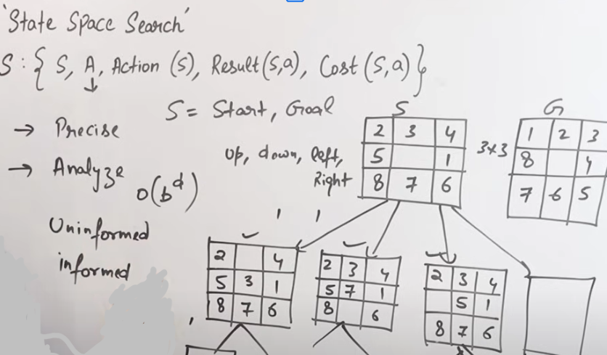
Goal Formation

Slide 7
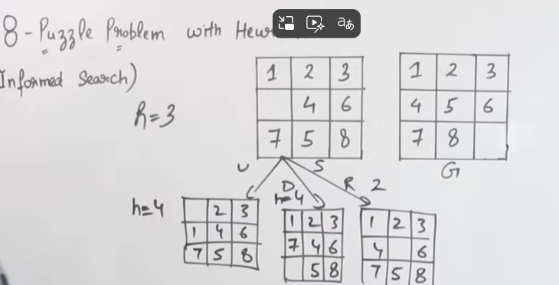
Goal Formation

Slide 8
Problem Formation
It is the most important step of problem-solving which decides what actions should be taken to achieve the formulated goal
There are following five components involved in problem formulation
  Initial State
    It is the starting state or initial step of the agent towards its goal
    For example, if a taxi agent needs to get to location(B) but the taxi is currently at location(A) then the initial state of the problem would be location(A)
  Actions
    It is the description of the possible actions available to the agent
    Given a state s, Actions(s) returns the set of actions that can be executed in s
    We say that each of these actions is applicable in s

Slide 9
Problem Formation
  Transition Model
    It describes what each action does
    It is specified by a function Result(s, a) that returns the state that results from doing action a in state s
  Goal Test
    It determines if the given state is a goal state.
  Path cost
    It assigns a numeric cost to each path that follows the goal
    The problem-solving agent selects a cost function, which reflects its performance measure
    Remember, an optimal solution has the lowest path cost among all the solutions

Slide 10
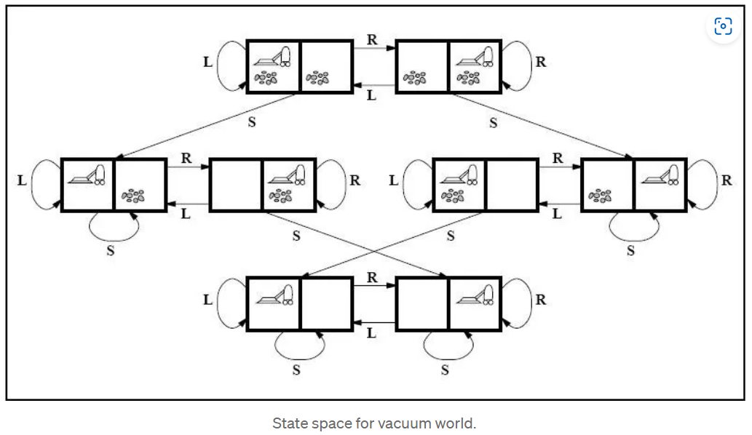
Problem Formation
An Example Problem Formulation
  Let us take the example of vacuum world that was introduced in the starting of this series, There is a vacuum cleaner agent and it can move left or right and its jump is to suck up the dirt from the floor

Slide 11
Problem Formation
The problem for vacuum world can be formulated as follows:
  _{States}
    The state is determined by both the agent location and the dirt location
    The agent is in one of two locations, each of which might or might not contain dirt
    Therefore, there are 2 x 2² = 8 possible world states.
      A larger environment would have n x 2 to the power of n states.
  _{Initial State}
    Any state can be assigned as the initial state in this case.
  _{Action}
    In this environment there are three actions, Move Left , Move Right , Suck up the dirt.

Slide 12
Problem Formation
The problem for vacuum world can be formulated as follows:
  _{Transition Model}
    All the actions have expected effects, except for when the agent is in leftmost square and the action is Left, when the agent is in rightmost square and the action is Right and the square is clean when the action is to Suck.
  _{Goal Test}
    Goal test checks whether all the squares are clean.
  _{Path Cost}
    Each step costs 1, so the path cost is the number of steps in the path.
  The vacuum world problem is a toy problem and involves only discrete locations, discrete dirt etc. Therefore, this problem is a Toy Problem
  There are many Real-World Problems like the automated taxi world
  Try to formulate problems of real world and see what would be the states be and what actions could be chosen etc

Slide 13
Steps in problem solving
Search
  It identifies all the best possible sequence of actions to reach the goal state from the current state
  It takes a problem as an input and returns solution as its output.
Solution
  It finds the best algorithm out of various algorithms, which may be proven as the best optimal solution.
Execution
  It executes the best optimal solution from the searching algorithms to reach the goal state from the current state.

Slide 14
SEARCH STRATEGY
the essence of search—following up one option now and putting the others aside for later, in case the first choice does not lead to a solution.
The set of all leaf nodes available for expansion at any given point is called the frontier.
The process of expanding nodes on the frontier continues until either a solution is found or there are no more states to expand.
Search algorithms all share this basic structure; they vary primarily according to how they choose which state to expand next —the so-called search strategy.

Slide 15
FRONTIER [FRINGE]
The frontier needs to be stored in such a way that the search algorithm can easily choose the next node to expand according to its preferred strategy. The appropriate data structure for this is a queue.
The operations on a queue are as follows:
• EMPTY(queue) returns true only if there are no more elements in the queue.
• POP(queue) removes the first element of the queue and returns it.
• INSERT(element, queue) inserts an element and returns the resulting queue.
Queues are characterized by the order in which they store the inserted nodes. Three common variants are -
the first-in, first-out For FIFO queue, which pops the oldest element of the queue;
the last-in, first-out or LIFO queue (also known as a stack), which pops the newest element of the queue; and
the priority queue,

Slide 16
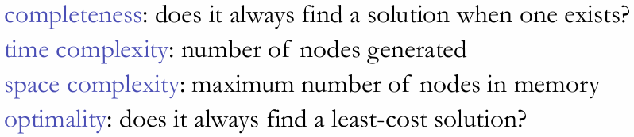
MEASURING PROBLEM-SOLVING PERFORMANCE

Slide 17
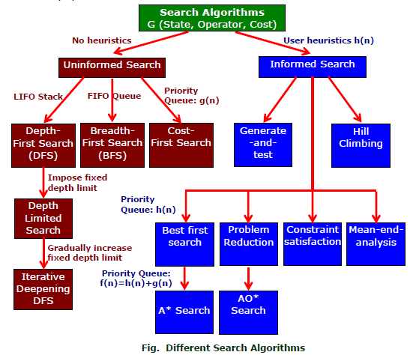
SEARCH ALGORITHMS

Slide 18
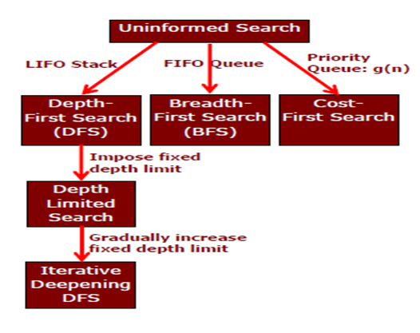
UNINFORMED
SEARCH STRATEGIES

Slide 19
Breadth-First Search
Breadth-first search is the most common search strategy for traversing a tree or graph
This algorithm searches breadthwise in a tree or graph, so it is called breadth-first search.
BFS algorithm starts searching from the root node of the tree and expands all successor node at the current level before moving to nodes of next level.
The breadth-first search algorithm is an example of a general-graph search algorithm.
Breadth-first search implemented using FIFO queue data structure.

Slide 20
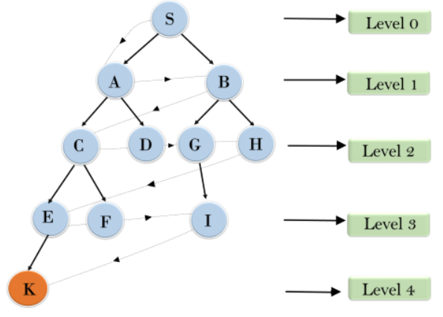
Breadth-First Search
S---> A--->B---->C--->D---->G--->H--->E---->F---->I---->K

Slide 21
Breadth-First Search
Time Complexity
  Time Complexity of BFS algorithm can be obtained by the number of nodes traversed in BFS until the shallowest Node
  Where the d= depth of shallowest solution and b is a node at every state.
  T (b) = 1+b²+b³+.......+ b^{d}= O (b^{d})
Space Complexity
  Space complexity of BFS algorithm is given by the Memory size of frontier which is O(b^{d}).
Completeness
  BFS is complete, which means if the shallowest goal node is at some finite depth, then BFS will find a solution.
Optimality
  BFS is optimal if path cost is a non-decreasing function of the depth of the node

Slide 22
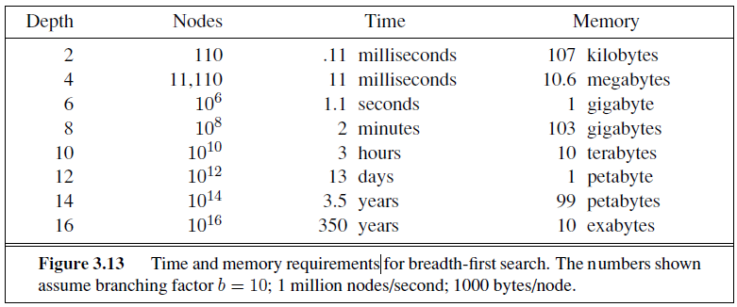
BREADTH-FIRST SEARCH:
MEMORY REQUIREMENTS

Slide 23
Uniform Cost Search
Uniform-cost search is a searching algorithm used for traversing a weighted tree or graph
This algorithm comes into play when a different cost is available for each edge
The primary goal of the uniform-cost search is to find a path to the goal node which has the lowest cumulative cost
Uniform-cost search expands nodes according to their path costs form the root node
It can be used to solve any graph/tree where the optimal cost is in demand
A uniform-cost search algorithm is implemented by the priority queue
It gives maximum priority to the lowest cumulative cost
Uniform cost search is equivalent to BFS algorithm if the path cost of all edges is the same.

Slide 24
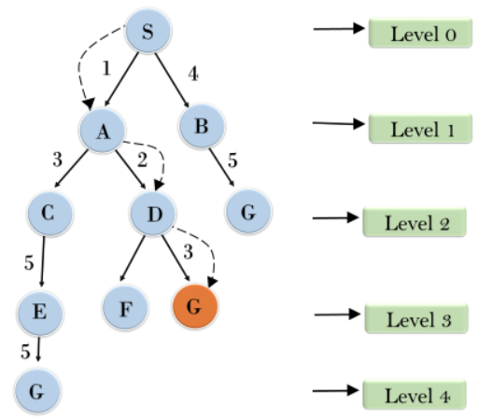
Uniform Cost Search

Slide 25
Uniform Cost Search
Completeness:
  Uniform-cost search is complete, such as if there is a solution, UCS will find it.
Time Complexity:
  Let C* is Cost of the optimal solution, and ε is each step to get closer to the goal node
  Then the number of steps is = C*/ε+1. Here we have taken +1, as we start from state 0 and end to C*/ε.
  Hence, the worst-case time complexity of Uniform-cost search isO(b1 + [C*/ε])/.
Space Complexity:
  The same logic is for space complexity so, the worst-case space complexity of Uniform-cost search is O(b1 + [C*/ε]).
Optimal:
  Uniform-cost search is always optimal as it only selects a path with the lowest path cost.

Slide 26
Depth-First Search
Depth-first search is a recursive algorithm for traversing a tree or graph data structure
It is called the depth-first search because it starts from the root node and follows each path to its greatest depth node before moving to the next path
DFS uses a stack data structure for its implementation
The process of the DFS algorithm is similar to the BFS algorithm.

Slide 27
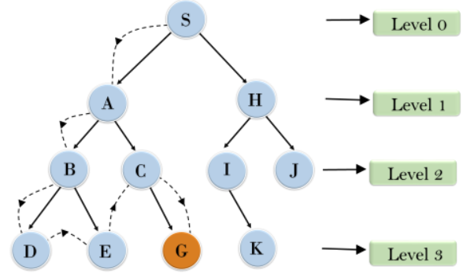
Depth-First Search
Root node--->Left node ----> right node
It will start searching from root node S, and traverse A, then B, then D and E, after traversing E, it will backtrack the tree as E has no other successor and still goal node is not found
After backtracking it will traverse node C and then G, and here it will terminate as it found goal node.

Slide 28
Depth-First Search
Time Complexity
  Time complexity of DFS will be equivalent to the node traversed by the algorithm. It is given by:
  T(n)= 1+ n2+ n3 +.........+ nm=O(nm)
  Where, m= maximum depth of any node and this can be much larger than d (Shallowest solution depth)
Space Complexity
  Space complexity of BFS algorithm is given by the Memory size of frontier which is O(b^{d}).\
  DFS algorithm needs to store only single path from the root node, hence space complexity of DFS is equivalent to the size of the fringe set, which is O(bm).
Completeness
  DFS search algorithm is complete within finite state space as it will expand every node within a limited search tree.
Optimality
  DFS search algorithm is non-optimal, as it may generate a large number of steps or high cost to reach to the goal node.

Slide 29
Depth-Limited Search
A depth-limited search algorithm is similar to depth-first search with a predetermined limit
Depth-limited search can solve the drawback of the infinite path in the Depth-first search. In this algorithm, the node at the depth limit will treat as it has no successor nodes further
Depth-limited search can be terminated with two Conditions of failure:
  Standard failure value: It indicates that problem does not have any solution.
  Cutoff failure value: It defines no solution for the problem within a given depth limit.

Slide 30
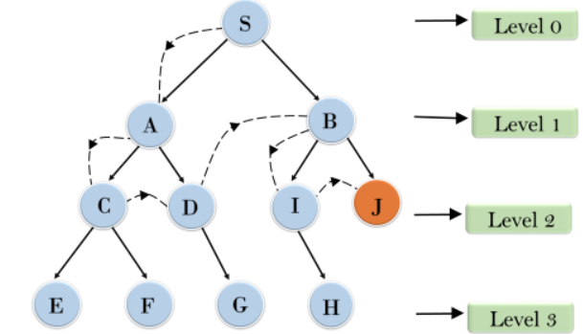
Depth-Limited Search

Slide 31
Depth-Limited Search
Time Complexity
  Time complexity of DFS will be equivalent to the node traversed by the algorithm. It is given by:
  T(n)= 1+ n2+ n3 +.........+ nm=O(nm)
  Where, m= maximum depth of any node and this can be much larger than d (Shallowest solution depth)
Space Complexity
  Space complexity of BFS algorithm is given by the Memory size of frontier which is O(b^{d}).\
  DFS algorithm needs to store only single path from the root node, hence space complexity of DFS is equivalent to the size of the fringe set, which is O(bm).
Completeness
  DFS search algorithm is complete within finite state space as it will expand every node within a limited search tree.
Optimality
  DFS search algorithm is non-optimal, as it may generate a large number of steps or high cost to reach to the goal node.

Slide 32
Iterative Deepening Depth-First Search
The iterative deepening algorithm is a combination of DFS and BFS algorithms
This search algorithm finds out the best depth limit and does it by gradually increasing the limit until a goal is found.
This algorithm performs depth-first search up to a certain "depth limit", and it keeps increasing the depth limit after each iteration until the goal node is found.
This Search algorithm combines the benefits of Breadth-first search's fast search and depth-first search's memory efficiency.
The iterative search algorithm is useful uninformed search when search space is large, and depth of goal node is unknown.

Slide 33
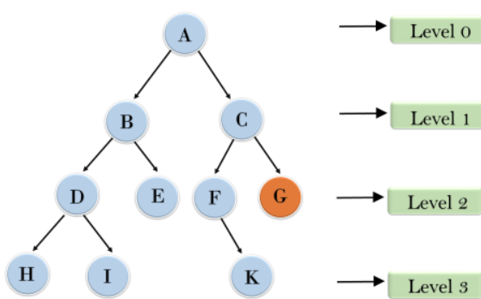
Iterative Deepening Depth-First Search
1'st Iteration-----> A
2'nd Iteration----> A, B, C
3'rd Iteration------>A, B, D, E, C, F, G
4'th Iteration------>A, B, D, H, I, E, C, F, K, G

Slide 34
Iterative Deepening Depth-First Search
Time Complexity
  Let's suppose b is the branching factor and depth is d then the worst-case time complexity is O(bd).
Space Complexity
  The space complexity of IDDFS will be O(bd).
Completeness
  This algorithm is complete is if the branching factor is finite.
Optimality
  IDDFS algorithm is optimal if path cost is a non- decreasing function of the depth of the node.

Slide 35
Bidirectional Search
Bidirectional search algorithm runs two simultaneous searches, one form initial state called as forward-search and other from goal node called as backward-search, to find the goal node
Bidirectional search replaces one single search graph with two small subgraphs in which one starts the search from an initial vertex and other starts from goal vertex
The search stops when these two graphs intersect each other.
Bidirectional search can use search techniques such as BFS, DFS, DLS, etc

Slide 36
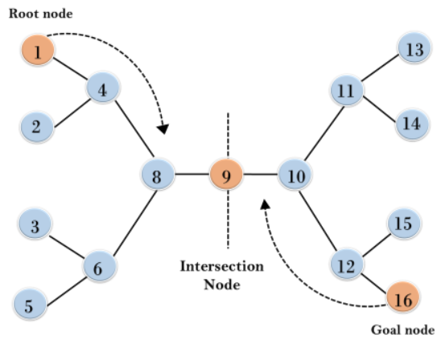
Bidirectional Search
In the below search tree, bidirectional search algorithm is applied
This algorithm divides one graph/tree into two sub-graphs
It starts traversing from node 1 in the forward direction and starts from goal node 16 in the backward direction.
The algorithm terminates at node 9 where two searches meet.

Slide 37
Bidirectional Search
Time Complexity
  Let's suppose b is the branching factor and depth is d then the worst-case time complexity is O(bd).
Space Complexity
  The space complexity of IDDFS will be O(bd).
Completeness
  This algorithm is complete is if the branching factor is finite.
Optimality
  IDDFS algorithm is optimal if path cost is a non- decreasing function of the depth of the node.

Slide 38
Exercise
Discuss completeness and optimality of BFS, DFS.
Explain the “Optimality” properties of the depth-first search algorithm.
Give an example where breadth first search(BFS) will give optimal result.

Slide 39
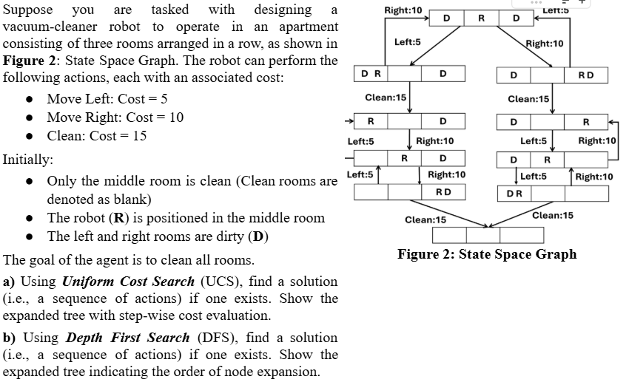
Exercise

Slide 40
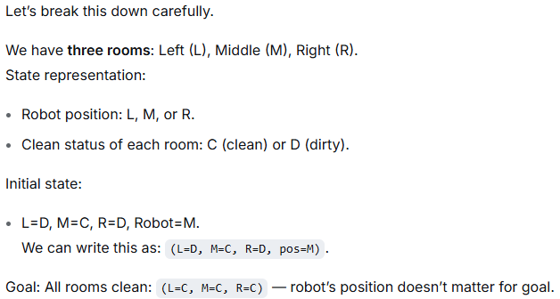
Solution

Slide 41
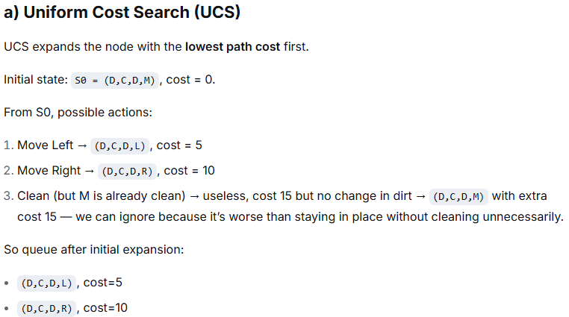
Solution

Slide 42
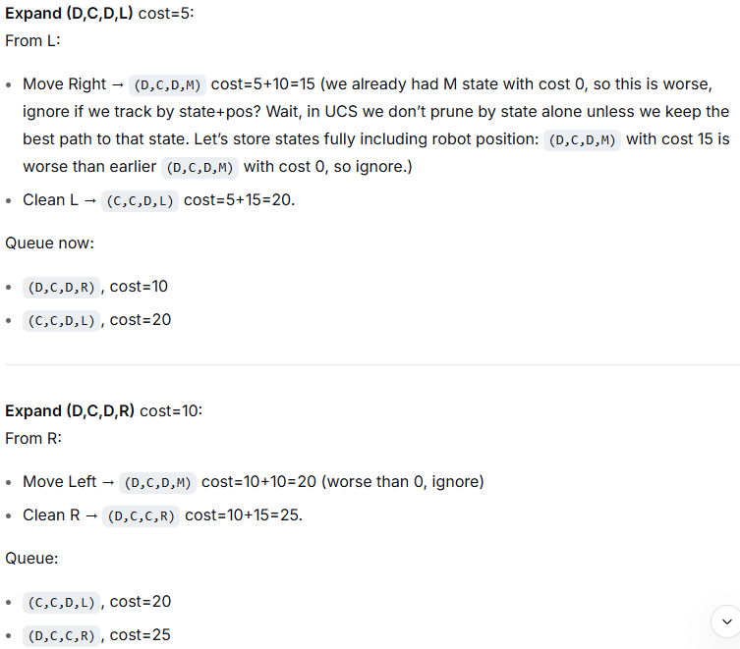
Solution

Slide 43
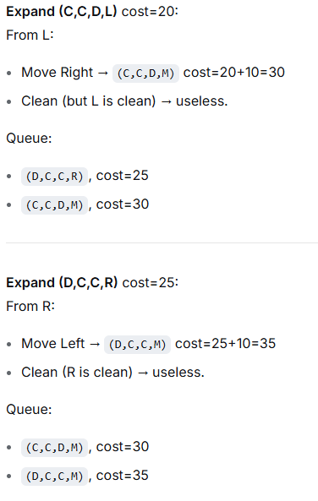
Solution

Slide 44
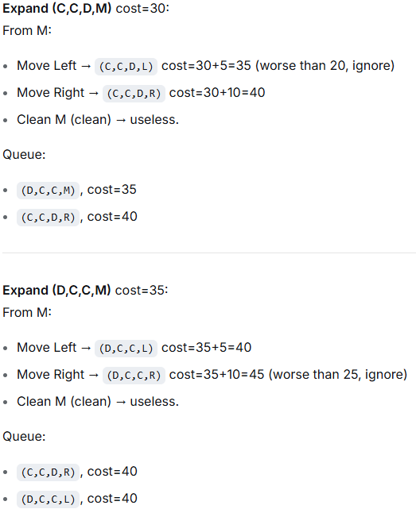
Solution

Slide 45
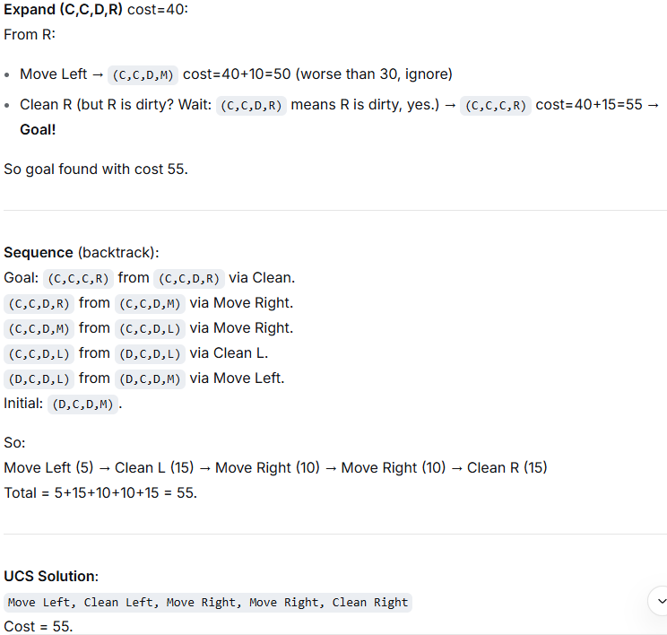
Solution

Slide 46
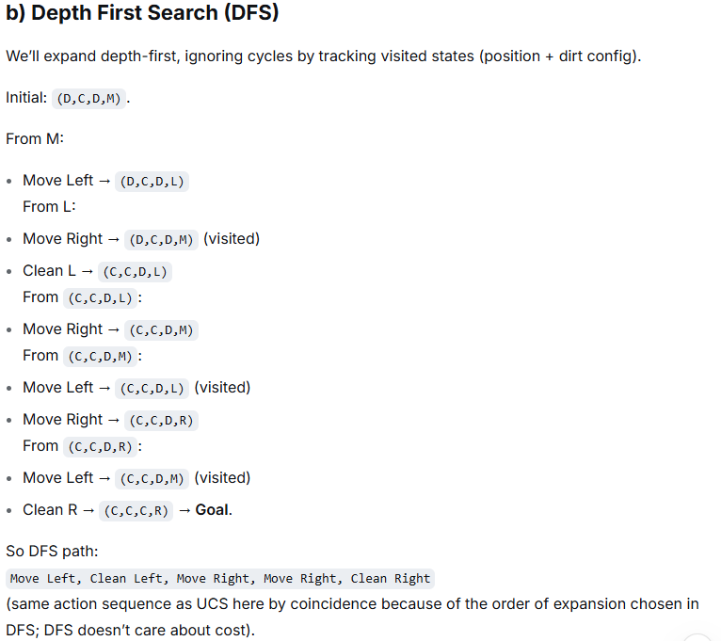
Solution

Slide 47
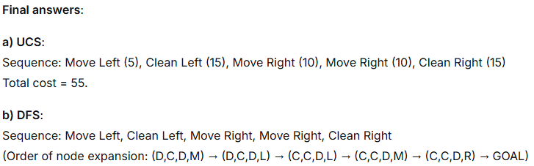
Solution

Slide 48
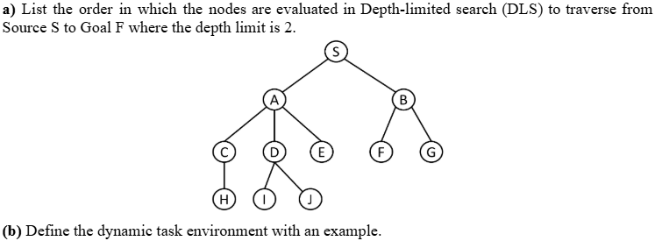
Exercise

Slide 49
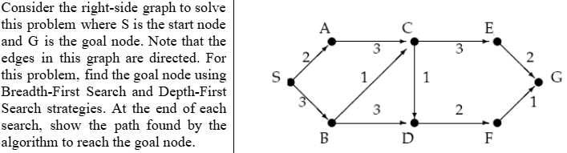
Exercise

Slide 50
Exercise
Suppose that you must design a vacuum-cleaner robot, which will operate in an apartment with 3 rooms in a row. It has the following allowed actions with the associated costs: move left (L: 5), move right (R: 10), and clean (C: 15). Initially, only the middle room was clean, the robot was there, and the other rooms were dirty. The goal of the agent is to make all the rooms clean.
Draw the complete state space graph.
Find the solution (sequence of actions) using Uniform Cost Search (use graph search algorithm).

Slide 51
Exercise
Exercise
Suppose you are designing an artificially intelligent wall-painting robot. The wall is divided into 144 squares, arranged in a 12 × 12 grid. The robot can paint one square per action and then move its arm to the next square to continue painting. The task is complete when the entire wall is painted.
  Provide a formal description of this task as a search problem (specifying the components: initial state, actions, transition model, goal test, and path cost).
  Determine the size of the state space.
  Identify whether the agent’s environment is: Single-agent or Multi-agent, Fully observable or Partially observable, Episodic or Sequential, Static or Dynamic, Deterministic or Stochastic

Slide 52
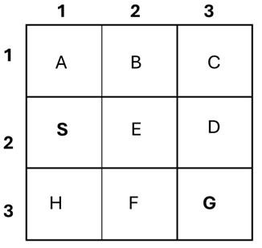
Exercise
Suppose you are designing a robot which must navigate through a maze (Figure 1: 3x3 Maze) to reach a specific destination. In the 3x3 grid, the robot can move Up, Right, Down, Left and will start in location S(2,1) and the goal is location G(3,3). Find the solution (sequence of actions) using Breadth First Search (Graph Search Algorithm) [Show frontier, explore set, expanded tree].

Slide 53
Solution
Assume the robot can move Up, Right, Down, Left and we expand successors in that order (Up → Right → Down → Left)
I show the frontier as a queue (front → back), the explored set, which node was expanded, and the parent used to build the tree. Stop when the goal is reached.
Labels / coordinates used
A = (1,1), B = (1,2), C = (1,3)
S = (2,1), E = (2,2), D = (2,3)
H = (3,1), F = (3,2), G = (3,3)
Start: S. Frontier is a FIFO queue.

Slide 54
Solution
BFS steps (frontier shown front → back)
Initialization
Frontier: [ S ]
Explored: { }
Parent: S: none
Expand S
Explored ← { S }
Successors (Up,Right,Down,Left) → A, E, H
Frontier: [ A, E, H ]
Parent: A←S, E←S, H←S
Expand A (front of queue)
Explored ← { S, A }
Successors → B (S is already explored)
Frontier: [ E, H, B ]
Parent: B←A

Slide 55
Solution
Expand E
Explored ← { S, A, E }
Successors → B (already in frontier), D, F, S (explored)
Frontier: [ H, B, D, F ]
Parent: D←E, F←E (B already has parent A)
Expand H
Explored ← { S, A, E, H }
Successors → S (explored), F (already in frontier)
Frontier: [ B, D, F ]
Expand B
Explored ← { S, A, E, H, B }
Successors → C (others explored)
Frontier: [ D, F, C ]
Parent: C←B

Slide 56
Solution
Expand D
Explored ← { S, A, E, H, B, D }
Successors → C (already in frontier), G ← goal found as successor
Frontier after enqueuing G: [ F, C, G ]
Parent: G←D
Parent pointers (summary)
S: none
E ← S
D ← E
G ← D
(Other parents: A ← S, B ← A, C ← B, F ← E, H ← S)
Reconstructed shortest path (from S to G)
Follow parents from G → D → E → S. Reverse: S → E → D → G

Slide 57
Solution
Sequence of actions for the robot
From S:
Right (S → E)
Right (E → D)
Down (D → G)
So the action sequence is: Right, Right, Down.
Expanded tree (parent-child style)
S
├─ A
│ └─ B
│ └─ C
├─ E
│ ├─ D
│ │ └─ G ← goal
│ └─ F
└─ H

Slide 58
Exercise
Suppose you are designing a robot which must navigate through a maze (Figure 1: 3x3 Maze) to reach a specific destination. In the 3x3 grid, the robot can move up, right, down, and left and will start in location S(2,1) and the goal is location G(3,3). Find the solution (sequence of actions) using Depth First Search (Graph Search Algorithm) [Show frontier, explore set, expanded tree].

Slide 59
Solution
Coordinates / labels:
  A=(1,1), B=(1,2), C=(1,3)
  S=(2,1), E=(2,2), D=(2,3)
  H=(3,1), F=(3,2), G=(3,3)
Successor (direction) order we intend to explore: Up → Right → Down → Left.
In a DFS implementation that uses a stack, to visit Up first we push successors onto the stack in reverse order (Left, Down, Right, Up).
Graph-search: do not add a successor if it is already in the explored set or already in the frontier (stack).
Initialization
Stack (frontier) — show as [ bottom , … , top ] with the rightmost element being the top.
Frontier: [ S ] (top = S)
Explored: { }
Parents: S: none

Slide 60
Solution
Step-by-step DFS (expand → generate successors → push in reverse so Up explored first)
1. Expand S (pop top = S)
Explored ← { S }
Successors (Up,Right,Down,Left) = A, E, H
Push reverse: H, E, A (skip none)
Frontier (stack) = [ H, E, A ] (top = A)
Parents: A ← S, E ← S, H ← S
2. Expand A (pop top = A)
Explored ← { S, A }
Successors = B (S is already explored)
Push reverse [B] → Frontier = [ H, E, B ] (top = B)
Parent: B ← A

Slide 61
Solution
3. Expand B (pop top = B)
Explored ← { S, A, B }
Successors = (Up none, Right C, Down E, Left A) → list [C, E, A]
Reverse push order = [ A, E, C ] but skip A (explored) and skip E because E is already in frontier. So only push C.
Frontier = [ H, E, C ] (top = C)
Parent: C ← B
4. Expand C (pop top = C)
Explored ← { S, A, B, C }
Successors = (Up none, Right none, Down D, Left B) → [D, B]
Reverse push order = [ B, D ] — skip B (explored), push D.
Frontier = [ H, E, D ] (top = D)
Parent: D ← C

Slide 62
Solution
3.5. Expand D (pop top = D)
Explored ← { S, A, B, C, D }
Successors = (Up C, Right none, Down G, Left E) → [C, G, E]
Reverse push order = [ E, G, C ]
  E is in frontier already → skip
  G is not yet in frontier/explored → push G
  C explored → skip
Frontier = [ H, E, G ] (top = G)
Parent: G ← D
6. Expand G (pop top = G)
Explored ← { S, A, B, C, D, G }
Goal found. Stop.

Slide 63
Solution
Parent / path reconstruction
Parents collected while generating:
A ← S
E ← S, H ← S
B ← A
C ← B
D ← C
G ← D
Trace back from G: G ← D ← C ← B ← A ← S → reverse →
Path found by DFS: S → A → B → C → D → G
Sequence of actions (moves)
From coordinates:
S(2,1) → A(1,1) = Up
A(1,1) → B(1,2) = Right
B(1,2) → C(1,3) = Right
C(1,3) → D(2,3) = Down
D(2,3) → G(3,3) = Down
Action sequence: Up, Right, Right, Down, Down (5 moves)

Slide 64
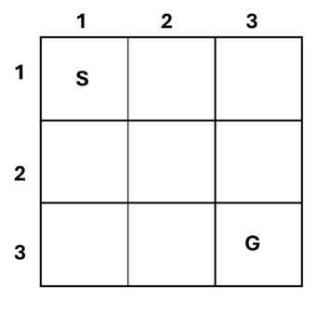
Exercise
Suppose you are designing a robot that must navigate through a 3×3 maze (see Figure 1: 3×3 Maze) to reach a designated goal. The robot can move in four directions: up, right, down, and left.
The robot starts at location S and the goal is at G. Solve the problem using Depth-First Search (DFS).
Clearly show the following: Frontier (Queue) updates at each step, Explored set, Expanded tree structure, Final path from S to G.

Slide 65
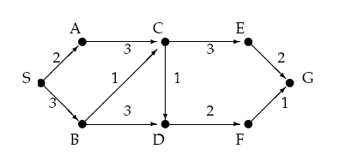
Exercise
Consider the right-side graph to solve this problem where S is the start node and G is the goal node. Note that the edges in this graph are directed. For this problem, find the goal node using Breadth-First Search and Depth-First Search strategies. At the end of each search, show the path found by the algorithm to reach the goal node

Slide 66
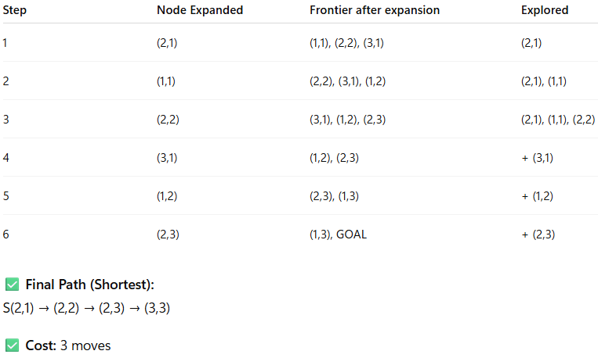
Solution

Slide 67
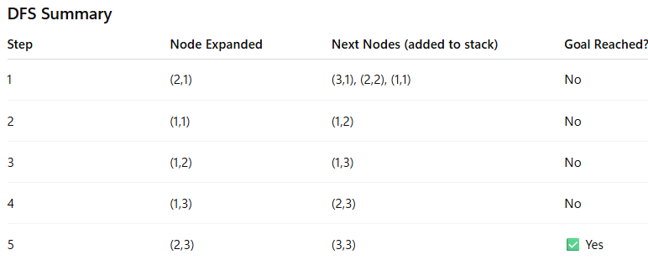
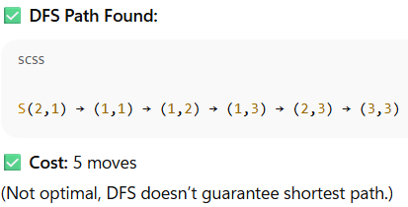
Solution

Slide 68
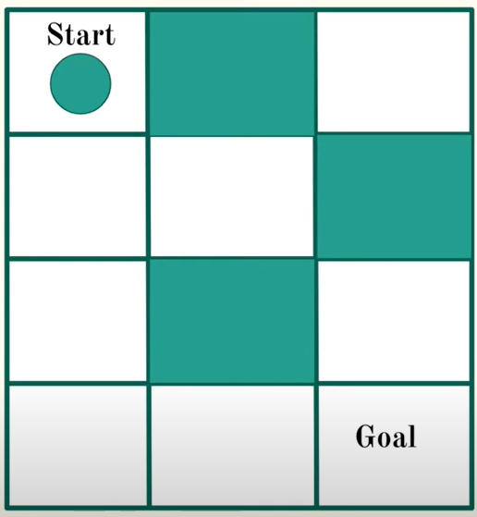

Slide 69
